Slide 1
Lecture Week 3
Financial Statements

Slide 2
Financial Statements
Income Statement
Statement of Owner’s Equity
Statement of Financial Position (Balance Sheet)
Statement of Cash Flows
Analyze
Journalize
Post
Trial Balance
Adjusting Entries
Adjusted Trial Balance
Financial Statements
Closing Entries

Slide 3
The Four Financial Statements
Companies prepare four financial statements:
Income Statement |  | Owner's Equity Statement |  | Statement of Financial Position (Balance Sheet) |  | Statement of Cash Flows
Financial Statements are prepared directly from the Adjusted Trial Balance.

Slide 4
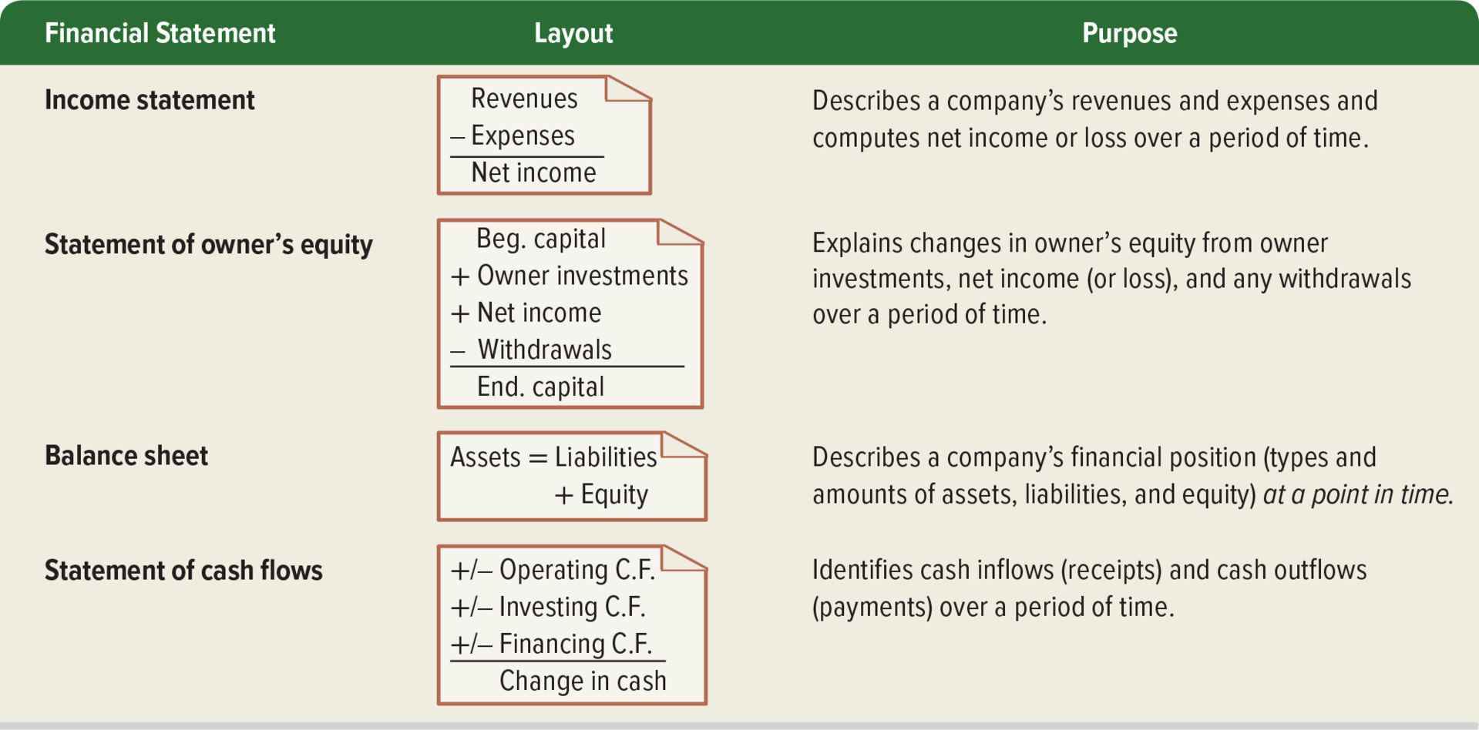

Slide 5
Income Statement
Income Statement describes a company’s revenues and expenses along with the resulting net income or loss over a period of time due to earnings activities. The income statement provides a summary of the business operations or activities during the period, it is considered as a video recording of the business activities that results in either generating gains or losses to the business.

Slide 6
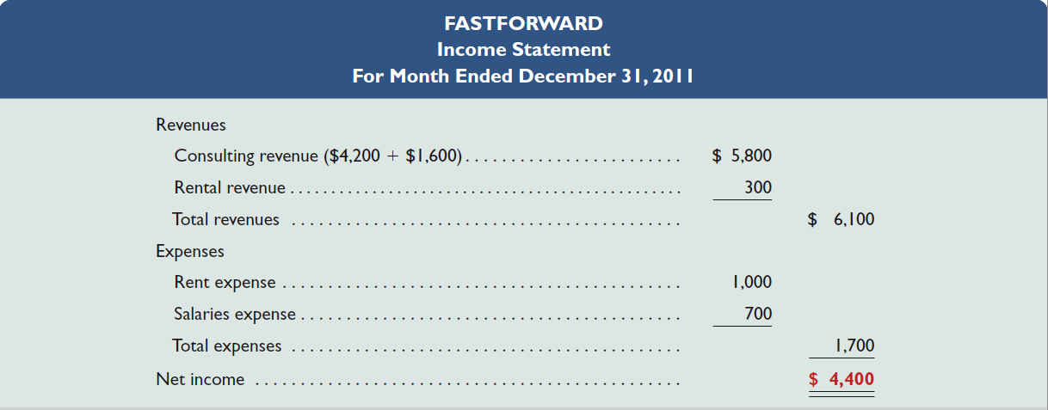
Income Statement
Financial statements have a three line title with the company name, the name of the statement, and the period covered by the report.
Reports revenues and expenses for a specific period of time.
Lists revenues first, followed by expenses.
Shows net income (or net loss)
Net income occurs when revenues exceed expenses.
. Net loss occurs when expenses exceed revenues .
In our case, we had total revenues of $6,100 and total expenses of $1,700, so net income for the month ended December 31, 2011, was $4,400.

Slide 7
Income Statement
Revenue: recorded when service is provided or product is sold regardless when the cash is received.
Expense:
matched with the revenue they helped to generate.
It includes:
1- cost of sales or cost of goods sold which is the main expenses required to earn the main revenue of the business.
2- operating expenses which are expenses required to generate the revenue through operating the business, interest expenses, and loss on sale of assets.

Slide 8
Income Statement
There are two types of Income statement:
Single-step Income Statement
Multiple-step Income Statement

Slide 9
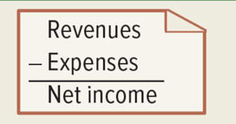
Single-step Income Statement
In this type all the revenues and expenses are combined together and then we reach to the net income.
This single step income statement is very simple to prepare and easy to understand and doesn’t require any judgements on which revenues and expenses are related to operating activities and which are not.

Slide 10
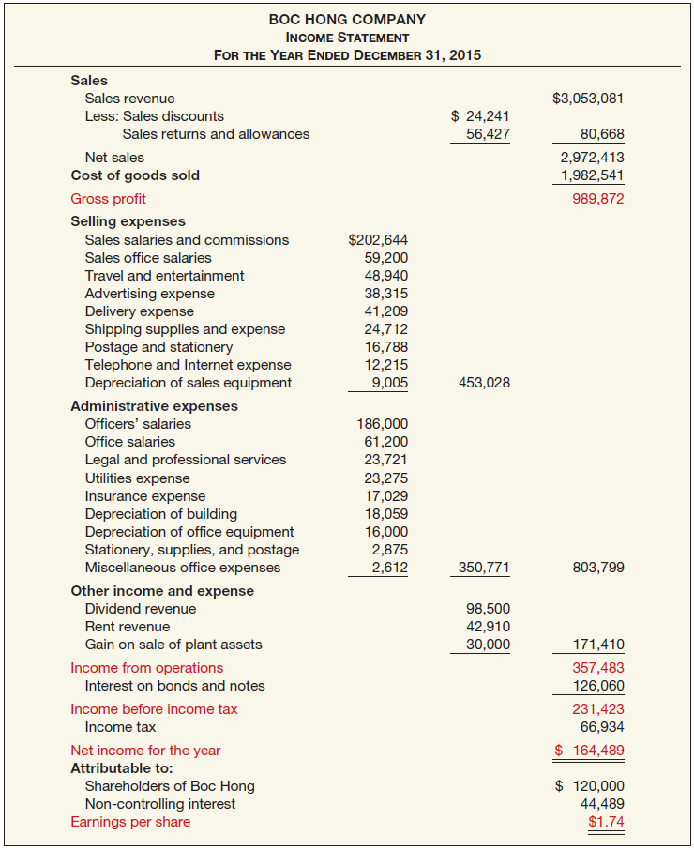
Multiple-Step Income Statement

Slide 11
Multiple-step Income Statement
This is a detailed income statement that provides further classifications of costs and revenues as operating and non-operating to provide further insights on the financial health of the business.
Unlike the single-step income statement, the multiple-step reports gross profit that shows how efficiently the company uses its resources to generate revenue from its main operations.
This gross profit is important metric of the company’s performance, by comparing between the gross-profit over years we can identify if there are any problems in the company ability to generate revenues from its main operations.
if it is decreasing this may either mean that the company sales are not increasing or that the company is selling at discounts, or that it has high cost of goods sold.

Slide 12
Multiple-step Income Statement
Then, the company report the operating income by deducting the selling and admin expenses from the gross profit this may include rent expense, advertising, salaries expenses, depreciation of office equipment.
In general, the IASB (International Accounting Standards Board)takes the position that both revenues and expenses and other income and expense should be reported as part of income from operations.
This operating income shows that profit from the primary business activities after including all the expenses required to generate sales (this is called earnings before interest and taxes EBIT).
Then, the finance expenses (Interest expense) are deducted to reach to the income before tax, then taxes are deducted to get the Net Income.
Notes:
Examples of other income and expenses:
Gains or losses on the disposal of items of property, plant, and, equipment or investments.
Losses on write-downs of inventories to net realizable value or of property, plant, and equipment to recoverable amount.
أمثلة على الإيرادات والمصروفات الأخرى: أرباح أو خسائر استبعاد بنود الممتلكات والمنشآت والمعدات أو الاستثمارات. خسائر تخفيض قيمة المخزون إلى صافي القيمة الممكن تحقيقها أو الممتلكات والآلات والمعدات إلى القيمة القابلة للاسترداد.

Slide 13
STATEMENT OF OWNER’S EQUITY
Reports changes in owner’s equity for a specific period of time*
Indicates why owner’s equity has been increased or decreased during the period
The statement starts by showing beginning owner’s capital. Then events that increase it (owner investments and net income), and events that decrease it (withdrawals and net loss).
Ending capital is computed in this statement and is carried over and reported in the statement of financial position.
Notes:
For sole proprietorship and partnershipللملكية الفردية والشراكة

Slide 14
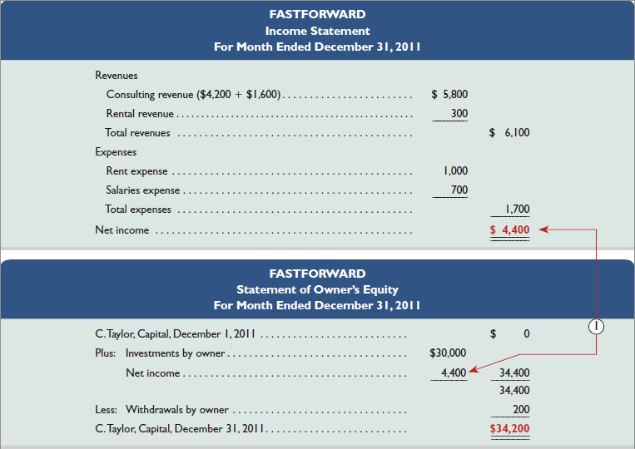
STATEMENT OF OWNER’S EQUITY

Slide 15
STATEMENT OF OWNER’S EQUITY
In the statement of owner's equity, we start with the balance at the beginning of the period, add new owner investments and net income earned during the period, and deduct any withdrawals paid, resulting in the ending balance in owner's equity.
FastForward was started this month, so the beginning balance in owner's equity was zero.
Chas Taylor invested $30,000 in the company at the beginning of the month.
During December, net income of $4,400 was earned. Notice that the net income flows from the income statement to the statement of owner’s equity. We must complete the income statement before we can begin working on the statement of owner’s equity.
In addition, $200 withdrawal was made by Chas Taylor, so the ending balance in owner's equity is $34,200. After we complete this statement, we can prepare the statement of financial position (balance sheet).

Slide 16
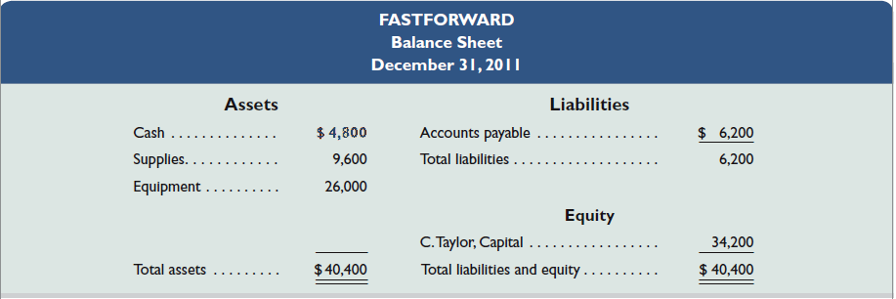
Statement of Financial Position
The statement of financial position (balance sheet) describes a company’s financial position at a point in time.

Slide 17
Statement of Financial Position
Reports assets, liabilities, and owner's equity at a specific date
Lists assets at top, followed by liabilities and owner’s equity (report form). It can also be presented in an account form.
Total assets must equal total owner’s equity and liabilities
Provides information about resources, obligations to creditors, and equity in net resources.
Also referred to as Balance Sheet.

Slide 18
Statement of Financial Position
The statement of financial position is a summary of assets, liabilities and equity at the end of the month. Our total assets are equal to $40,400. This includes cash of $4,800, supplies of $9,600, and equipment of $26,000.
Liabilities include accounts payable of $6,200.
Equity is composed of C. Taylor, Capital of $34,200. The account C.Taylor, Capital flows directly from the statement of owner’s equity. You can see that the books are in balance because total assets are equal to total liabilities plus equity.
Creditors have claims against our assets of $6,200. The owner has claims to assets of $34,200.

Slide 19
Classified Statement of Financial Position

Slide 20
Cheng Ltd. Statement of Financial Position October 31, 2020
Assets
Current assets
Cash |  |  | NT$ 6,600
Short-term investments |  |  | 2,000
Accounts receivable |  |  | 7,000
Notes receivable |  |  | 1,000
Inventory |  |  | 3,000
Supplies |  |  | 2,100
Prepaid insurance |  |  | 400
Total current assets |  |  |  |  | NT$22,100
Long-term investments
Stock investments |  |  | 5,200
Investment in real estate |  |  | 2,000 |  | 7,200
Property, plant, and equipment
Land |  |  | 10,000
Equipment | NT$24,000
Less: Accumulated depreciation– equipment | 5,000 |  | 19,000 |  | 29,000
Intangible assets
Patents |  |  |  |  | 3,100
Total assets |  |  |  |  | NT$61,400

Slide 21
Cheng Ltd. Statement of Financial Position October 31, 2020
Liabilities and Owner’s Equity
Current liabilities
Notes payable |  |  | NT$ 11,000
Accounts payable |  |  | 2,100
Unearned service revenue |  |  | 900
Salaries and wages payable |  |  | 1,600
Interest payable |  |  | 450
Total current liabilities |  |  |  |  | NT$16,050
Long-term liabilities
Mortgage payable |  |  | 10,000
Notes payable |  |  | 1,300
Total long-term liabilities |  |  |  |  | 11,300
Total liabilities |  |  |  |  | 27,350
Owner’s equity
Owner’s capital |  |  |  |  | 34,050
Total liabilities and owner’s equity |  |  |  |  | NT$61,400

Slide 22
Classified Statement of Financial Position
Assets are grouped as current or noncurrent
A current asset is one that is expected to be converted into cash or use up within one year .
Examples: cash, short-term investments, accounts receivable, short-term notes receivable, merchandise inventory, and prepaid expenses.
Accounts usually listed in order of liquidity.

Slide 23
Long-Term Investments
Noncurrent Assets
Expected to be held for more than one year
Investments in stocks and bonds of other companies (purchased in order to control or own the other company)
Investments in non-current assets such as land or buildings that are not currently being used in operating activities
Long-term notes receivable

Slide 24
Property, Plant, and Equipment
Noncurrent Assets
Long useful lives
Currently used in operations (produce or sell products or services)
Include productive assets of the company along with any land containing structures such as buildings
They are all depreciable, except land (Depreciation - allocating the cost of assets to a number of years, Accumulated depreciation - total amount of depreciation expensed thus far in the asset’s life)
Book value is the cost of the asset less any accumulated depreciation
Sometimes called fixed assets or plant assets

Slide 25
Noncurrent Assets
Intangible Assets
Long-lived assets that do not have physical substance, used to produce and sell products and services
Patents, copyrights, trademarks, and goodwill
In general, it is very difficult to properly value intangible assets.

Slide 26
Current & Non-Current Liabilities
Current Liabilities
On the other side liabilities are divided between current and noncurrent
A current liability is one expected to be paid out of the company’s current assets within the longer of one year or the normal operating cycle.
Common examples are accounts payable, salaries and wages payable, notes payable, interest payable, income taxes payable, current maturities of long-term obligations.

Slide 27
Non-Current Liabilities
Obligations a company expects to pay after one year
Siemens Statement of Financial Position (partial) (in millions)
Non-current liabilities
Long-term debt |  | € 14,260
Mortgage Payable |  | 2,533
Deferred tax liabilities |  | 726
Other non-current liabilities |  | 2,752
 |  | €20,271

Slide 28
Owner’s Equity
Equity is the owner’s claim on the assets.
Equity is not separated into current and noncurrent categories.
Proprietorship - one capital account
Partnership - capital account for each partner
Corporation - Common Stock and Retained Earnings
Halie Capital Ltd. Statement of Financial Position (partial) (in thousands)
Equity
Share capital |  | £ 685,934
Retained earnings |  | 1,406,747
Total equity |  | £2,092,681

Slide 29
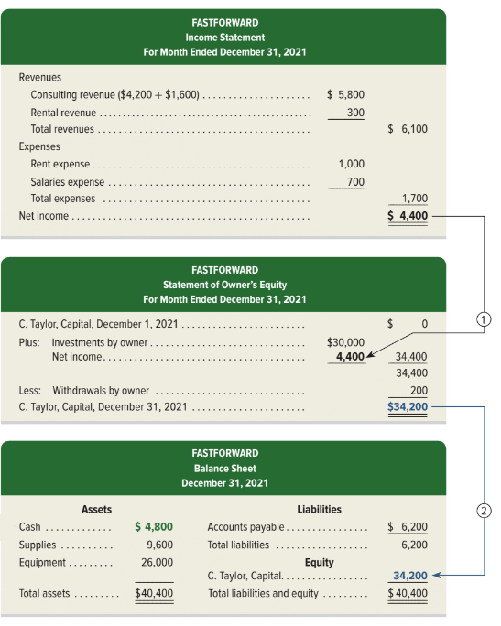
Exhibit 1.10: Financial Statements and Their Links – Part 1
Income Statement, Statement of Owner’s Equity and Balance Sheet
Exhibit 1.10
Learning Objective P2: Identify and prepare basic financial statements and explain how they interrelate.
© McGraw-Hill Education
Notes:
Financial Statements and Their Links.
Income Statement for FastForward includes revenues of $6,100 and expenses which total $1,700 for a net income of $4,400.
The Statement of Owner’s Equity has a beginning balance of $0, adds the owner investment of $30,000 and net income of $4,400 from the Income Statement, and subtracts owner withdrawals of $200 for an ending capital balance of $34,200.
The Balance Sheet shows total assets of $40,400 and total liabilities and equity of $40,400. Notice that the ending capital balance from the Statement of Owner’s Equity of $34,200 is brought forward into the Equity section of the Balance sheet. Adding the total liabilities of $6,200, we get Total liabilities and Equity of $40,400.

Slide 30
Quick Test
Presented below is selected information related to Li Fashions at December 31, 2020. Li reports financial information monthly.
Equipment | HK$10,000 | Utilities Expense | HK$4,000
Cash | 8,000 | Accounts Receivable | 9,000
Service Revenue | 36,000 | Salaries and Wages Expense | 7,000
Rent Expense | 11,000 | Notes Payable | 16,500
Accounts Payable | 2,000 | Owner’s Drawings | 10,000
a. Determine the total assets at December 31, 2020.
b. Determine the net income reported for December 2020.
c. Determine the owner’s equity at December 31, 2020.

Slide 31
Quick Test
Li reports financial information monthly.
Equipment | HK$10,000 | Utilities Expense | HK$4,000
Cash | 8,000 | Accounts Receivable | 9,000
Service Revenue | 36,000 | Salaries and Wages Expense | 7,000
Rent Expense | 11,000 | Notes Payable | 16,500
Accounts Payable | 2,000 | Owner’s Drawings | 10,000
a. Determine the total assets at December 31, 2020.
Cash | $ 8,000
Accounts receivable | 9,000
Equipment | 10,000
Total assets | $27,000

Slide 32
Quick Test
Li reports financial information monthly.
Equipment | HK$10,000 | Utilities Expense | HK$4,000
Cash | 8,000 | Accounts Receivable | 9,000
Service Revenue | 36,000 | Salaries and Wages Expense | 7,000
Rent Expense | 11,000 | Notes Payable | 16,500
Accounts Payable | 2,000 | Owner’s Drawings | 10,000
b. Determine the net income reported for December 2020.
Service revenue | $36,000
Rent expense | (11,000)
Salaries and wages expense | (7,000)
Utilities expense | (4,000)
Net income | $14,000

Slide 33
Quick Test
Li reports financial information monthly.
Equipment | HK$10,000 | Utilities Expense | HK$4,000
Cash | 8,000 | Accounts Receivable | 9,000
Service Revenue | 36,000 | Salaries and Wages Expense | 7,000
Rent Expense | 11,000 | Notes Payable | 16,500
Accounts Payable | 2,000 | Owner’s Drawings | 10,000
c. Determine the owner’s equity at December 31, 2020.
Total assets | $27,000
Less: Notes payable | (16,500)
Less: Accounts payable | (2,000)
Owner’s equity | $ 8,500

Slide 34
Quick Test; Classified Statement of Financial Position
Patents and copyrights are
Current assets
Intangible assets
Long-term investments
Property, plant, and equipment

Slide 35
Quick Test; Classified Statement of Financial Position
Which of the following is not a non-current liability?
Bonds payable
Current maturities of long-term obligations
Long-term notes payable
Mortgages payable

Slide 36
Quick Test; Statement of Financial Position Classifications
Match each of the following to its proper statement of financial position classification. If the item would not appear on a statement of financial position, use “NA.”
CL | Salaries and wages payable |  | LTI | Stock investments (long-term)
NA | Service revenue |  | PPE | Equipment
CL | Interest payable |  | PPE | Accumulated depreciation
IA | Goodwill |  | NA | Depreciation expense
CA | Debt investments (short-term) |  | OE | Owner’s capital
NCL | Mortgage payable (due in 3 years) |  | CL | Unearned service revenue
Current assets (CA) |  |  | Current liabilities (CL)
Long-term investments (LTI) |  |  | Non-current liabilities (NCL)
Property, plant, and equipment (PPE) |  |  | Owner’s equity (OE)
Intangible assets (IA)

Slide 37
Quick Test
Which of the following financial statements is prepared as of a specific date?
Statement of financial position
Income statement
Owner's equity statement
Statement of cash flows

Slide 38
Financial Statements for Corporation

Slide 39
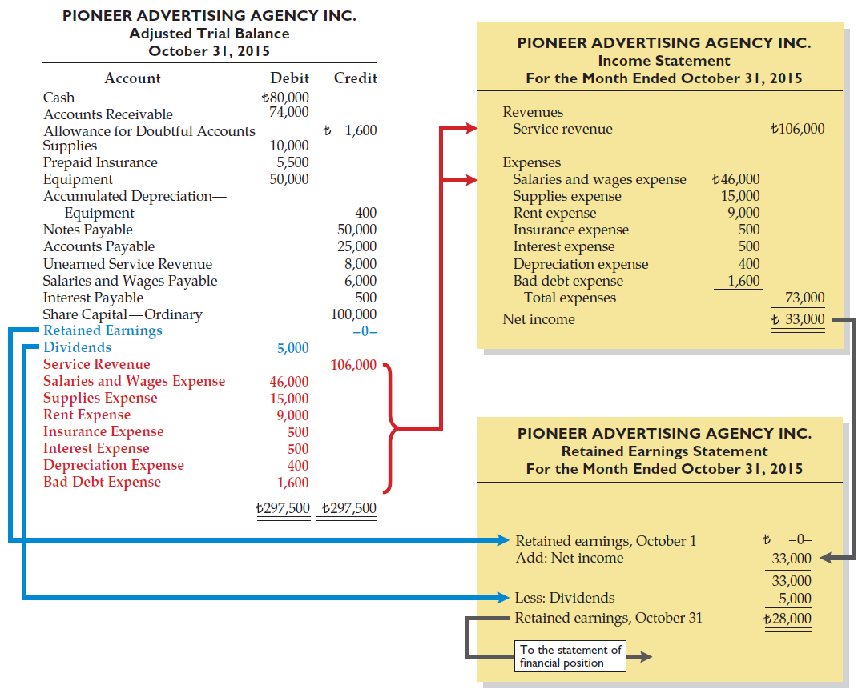
ILLUSTRATION 3-34 Preparation of the Income Statement and Retained Earnings Statement from the Adjusted Trial Balance

Slide 40
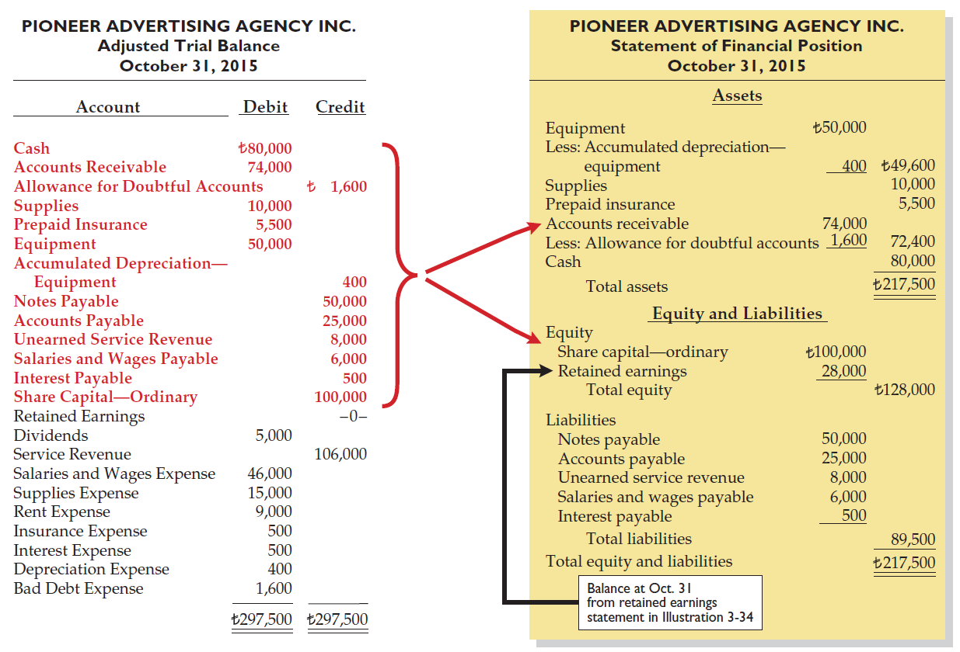

Slide 41
Statement of Cash Flows
Information on cash receipts and payments for a specific period of time
Answers the following:
Where did cash come from?
What was cash used for?
What was change in cash balance?
The statement reconciles to the ending cash balance of $4,800. Recall that the ending cash balance of $4,800 flows from the balance sheet to the statement of cash flows.

Slide 42
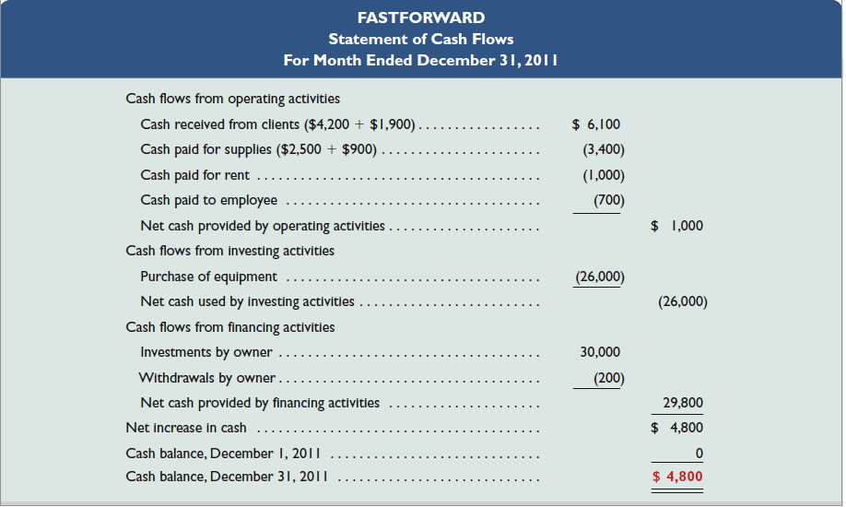
Statement of Cash Flows

Slide 43

Statement of Cash Flows
Notice that the statement is divided into three major sections:
Cash flows from operating activities which report cash receipts and payments from the primary business the company engages in (Net Income Transactions).
Cash flows from investing activities which involve cash transactions from buying and selling long-term assets (Non-current Assets).
Cash flows from financing activities which include long-term cash borrowings and repayments to lenders (Liabilities) and the cash investments from and withdrawals by the owner (Owner’s Equity).

Slide 44
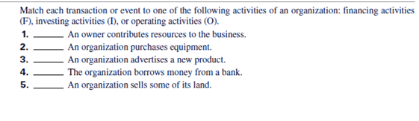
Quick Test: Statement of Cash Flows
1- Financing
2- Investing
3- Operating
4-Financing
5- Investing

Slide 45
Thank You

